Slide 1
Input File Editing Demo

Slide 2
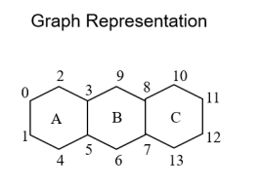
1.Adjacent Matrix
The structures are first labeled atomically, and the rings are labeled sequentially.
Please note that atomic labels start from zero.
1
2
3

Slide 3
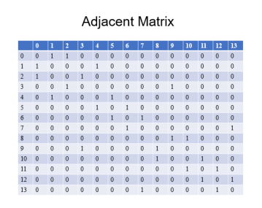
1.Adjacent Matrix
Adjacent matrix is a matrix of n*n.
(n is the number of C-atoms in the structure)
The value is 1 if there is a bond between the two atoms, and 0 otherwise.
The red box is the input information of the XLS file, and the column number next to it is only to locate the position of the input atom, which is not represented in the XLS file.

Slide 4
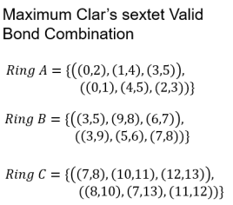
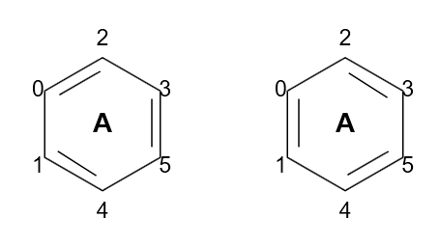
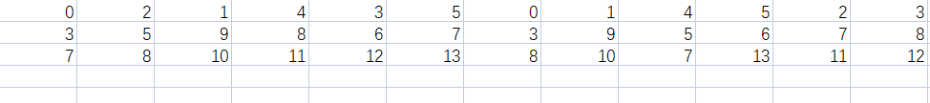
2.carbon-loop
Such as No.1 ring
1
1
1
1
2
3
2
3
1
2
3

Slide 5

3.carbon-reloop
Ajacent ring information
Ring 1 = (1,2)
Ring 2 = (1,2,3)
Ring 3 = (2,3)
1
2
3
1
2
3
For example, for ring No. 1, its neighboring rings (including itself) are 1, 2.

